Slide 1
Star wars survey data analysis
A presentation from a galaxy far, far away
Notes:
So this is my presentation on the star wars survey data analysis

Slide 2
Survey data Background
The data was taken from a survey conducted via SurveyMonkey on FiveThirtyEight.com
There were 1186 total respondents
The data includes questions about people’s opinion and attitude about Star Wars films:
Whether or not respondents have seen any of the original six movies
Whether or not respondents consider themselves to be fans of the franchise
Which of the original six movies they had seen
How they ranked each of the six movies
The data also includes how favorably they ranked the major characters
Each respondent also provides demographic data about themselves, such as their age, gender, location, household income and education
Notes:
The data was taken from a survey conducted on 538.com
There were about 1186 total responses to the survey
The data includes questions about people’s opinion and attitude about Star wars films, some of which you can see below
The data also includes how favorably they ranked the major characters, as well as demographic data about the respondents

Slide 3
DATA preparation
Notes:
Before we could analyze the data, it had to be cleaned up and formatted for the data exploration and analysis

Slide 4
Data Preparation
Changed the column names, and had separate columns for the sub-columns (check boxes)
Filled all the columns of whether respondents had seen each of the six movies with ‘Yes’ or ‘No’ if they had checked the box for that movie
Notes:
The first thing that we did is changed the column names, and had separate columns for the sub-columns (check boxes)
Filled all the columns of whether respondents had seen each of the six movies with ‘Yes’ or ‘No’ if they had checked the box for that movie

Slide 5
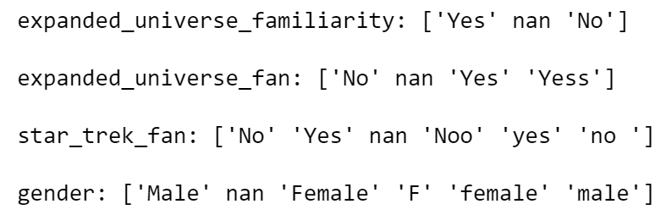
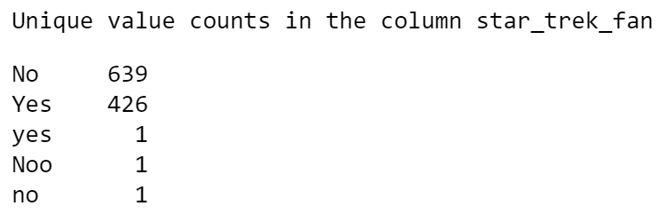
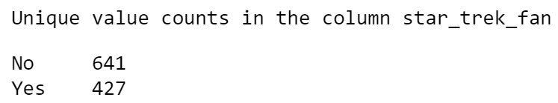
Data Preparation
Typo Correction
Looped through each column and printed out the unique values for that column.
Made necessary corrections to these typos:
Before
After
Notes:
Then we did some typo correction, for which we loop through each column and print out the unique values for that column.
Then we make the necessary corrections to these typos via masks, an example of which you can see here

Slide 6
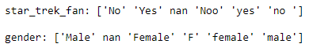
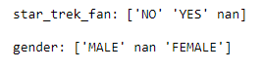
Data Preparation
Conversion to uppercase and removal of extra whitespace
Removed extra whitespaces, so our exploration functions don’t treat a response like ‘no ‘ and ‘no’ differently since they mean the same thing
Converted all text values to uppercase for parity
Before
After
Notes:
Then we removed any and all extra whitespaces so our exploration functions don’t treat the same responses differently because of extra whitespaces
Then we converted all text values to uppercase for parity across the dataset
Here you can see a sample before and after

Slide 7
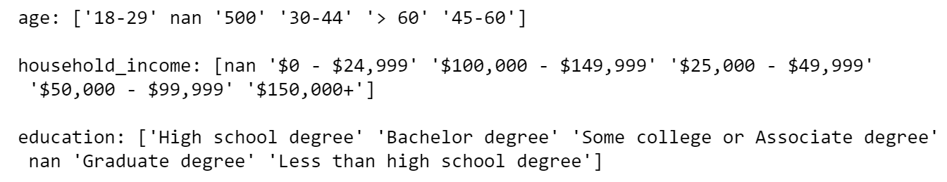
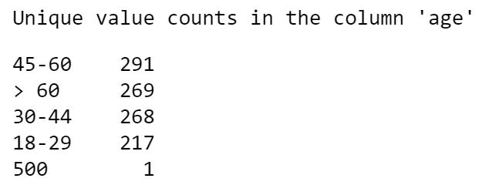
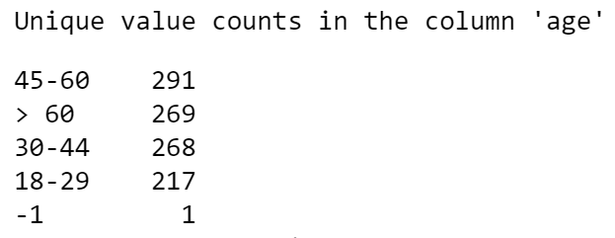
Data Preparation
Sanity checks
Looped through each column and printed out the unique values for that column.
Made necessary corrections:
Before
After
Notes:
Then we did some sanity checks, for which we looped through each column again, and checked if there were any values that seem out of place for that column, here we see it is the case for ‘age’, so we set that to a -1, which is how we treat the missing/blank data

Slide 8
Data Preparation
Missing Values
Missing values in the columns were dealt with by setting them all to (-1)
Putting a -1 allows us to easily identify occurrences of missing values in each column via indexing in the code
We did not take the column-wise mean because it doesn't work for most columns, as most columns aren't numeric, and the ones that are happened to represent ordinal data
Taking the column-wise median is a possibility, however, it may not accurately reflect the truth since some columns are interdependent.
Notes:
Missing values in the columns were dealt with by setting them all to (-1)
Putting a -1 allows us to easily identify occurrences of missing values in each column via indexing in the code
We did not take the column-wise mean because it doesn't work for most columns, as most columns aren't numeric, and the ones that are happened to represent ordinal data
Taking the column-wise median is a possibility, however, it may not accurately reflect the truth since some columns are interdependent. For example, it doesn't make sense to fill the column that has how people rank episode I with the median value because there might be rows in the data where people have not seen episode I. Also we don't want to assume values for people, that defeats the purpose of exploring the data

Slide 9
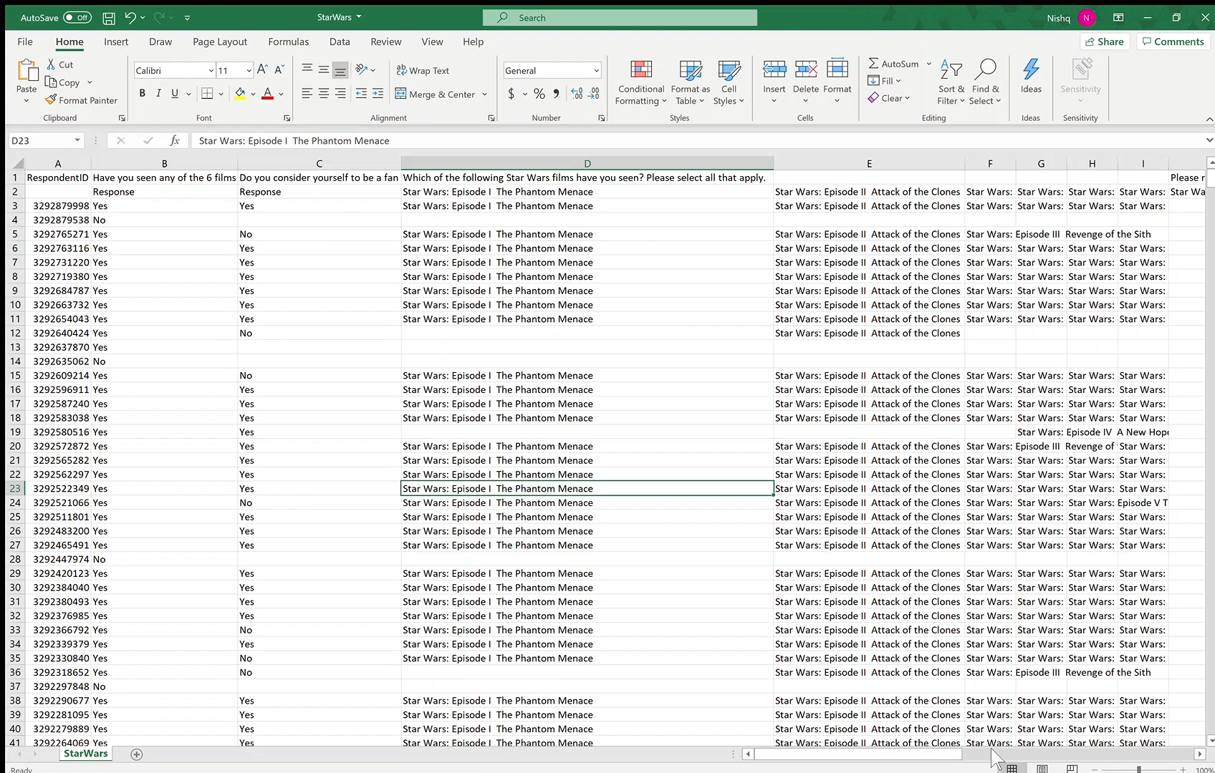
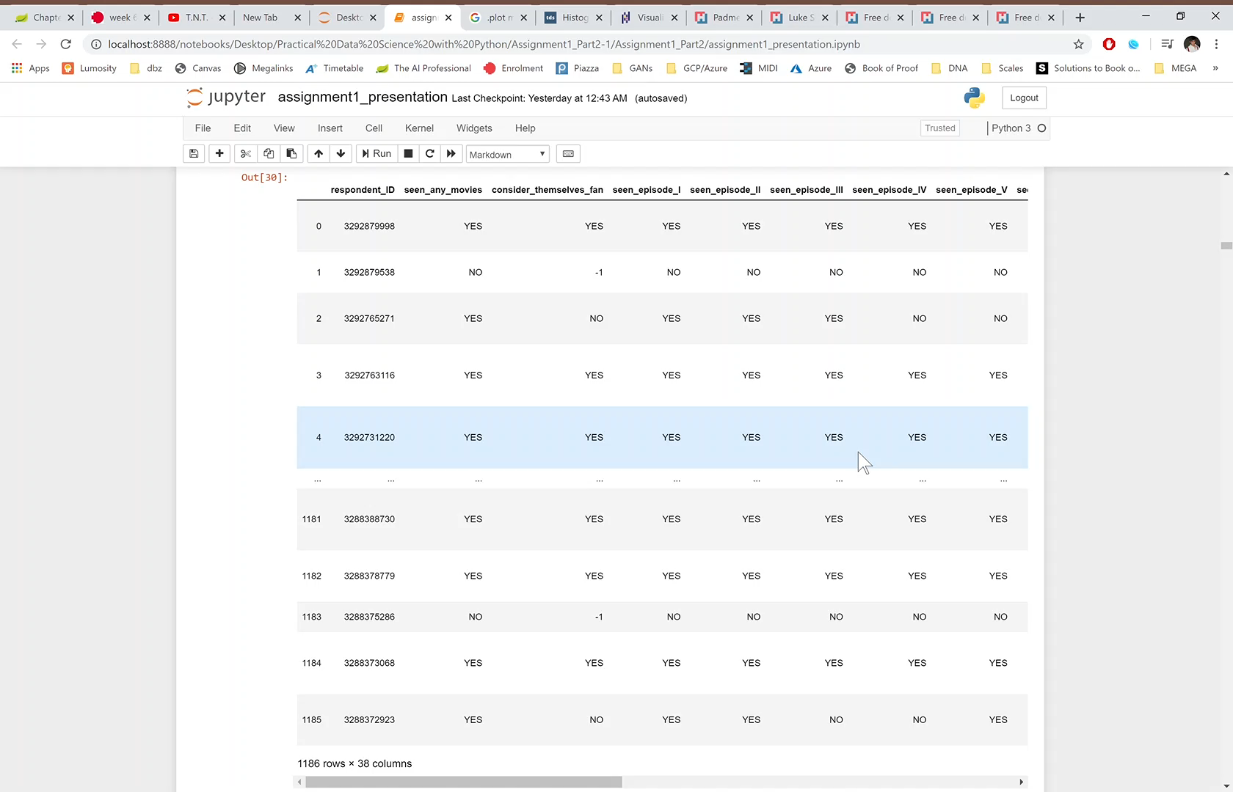
Data Preparation
Notes:
So here we can see what the data looked like before in excel, and how it looks after we do the steps mentioned above.

Slide 10
How do people Rank star wars movies?
Notes:
So this brings us to the Data Exploration and analysis. With our first question being ‘ How do people rank star wars movies?’

Slide 11
Data Exploration
First checked if people had ranked the episodes, even if they hadn’t seen them.
As an example, for Episode I, around 162 respondents marked that they had not seen this episode yet ranked it.
Thus we do not consider these rows when doing our analysis of the rankings as people who haven’t seen the movie shouldn’t be allowed to rate it.
Notes:
First checked if people had ranked the episodes, even if they hadn’t watched them.
As an example, for Episode I, around 162 respondents marked that they had not seen this episode yet ranked it.
Thus we do not consider these rows when doing our analysis of the rankings as people who haven’t seen the movie shouldn’t be allowed to rate it.

Slide 12
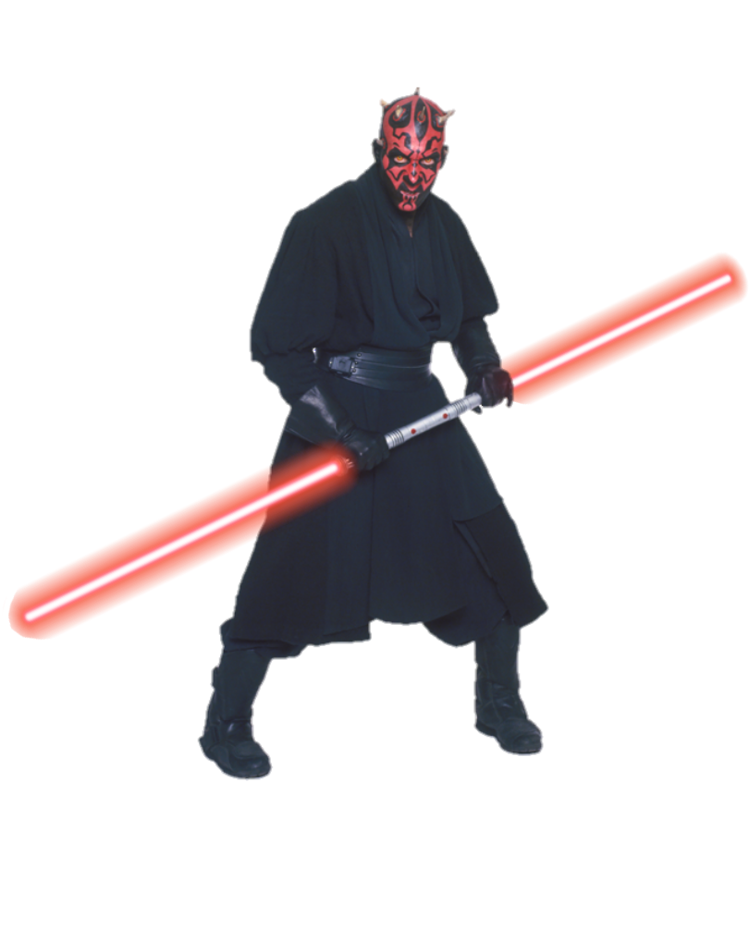
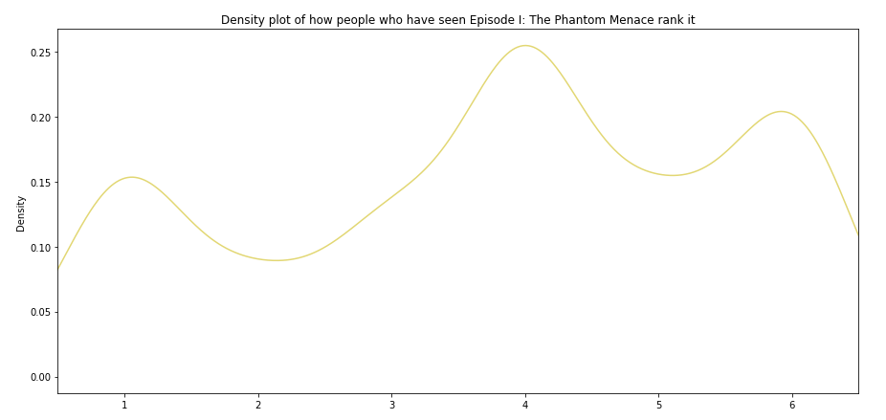
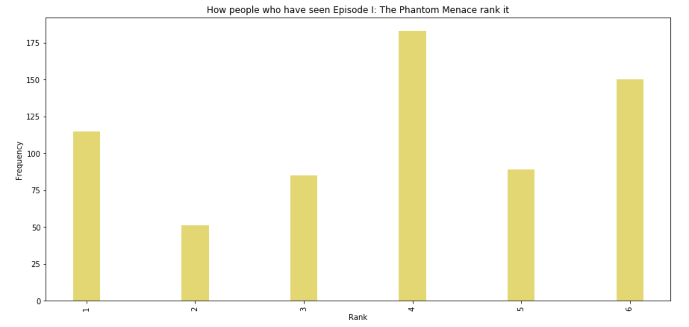
How people rank Episode i: The Phantom Menace
Notes:
So our first movie is Episode I, here we have a frequency graph of how people rank episode I, and we can see that a large number of people ranked it as the 4th best, with a large group following ranking it as the worst.
And here we can see the subsequent density plot of the same

Slide 13
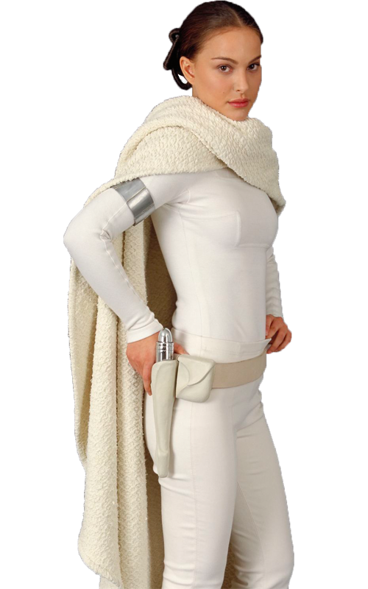
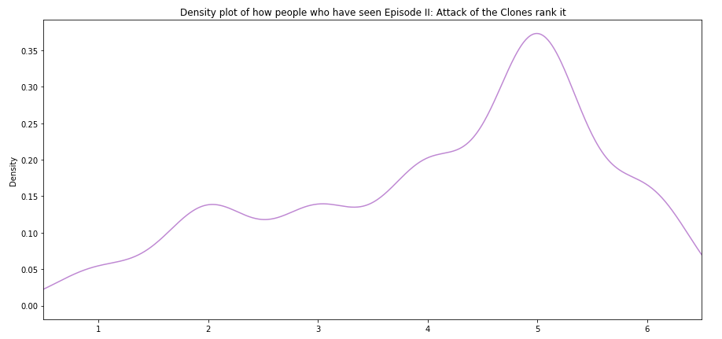
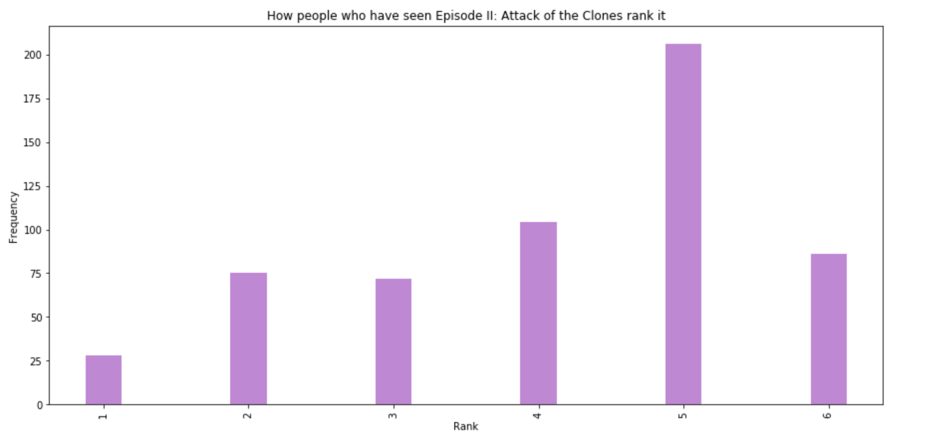
How people rank Episode ii: attack of the clones
Notes:
For episode 2, we can see that a majority of people ranked this movie as the 5th best or second worst,
And here is the density plot for the same.

Slide 14

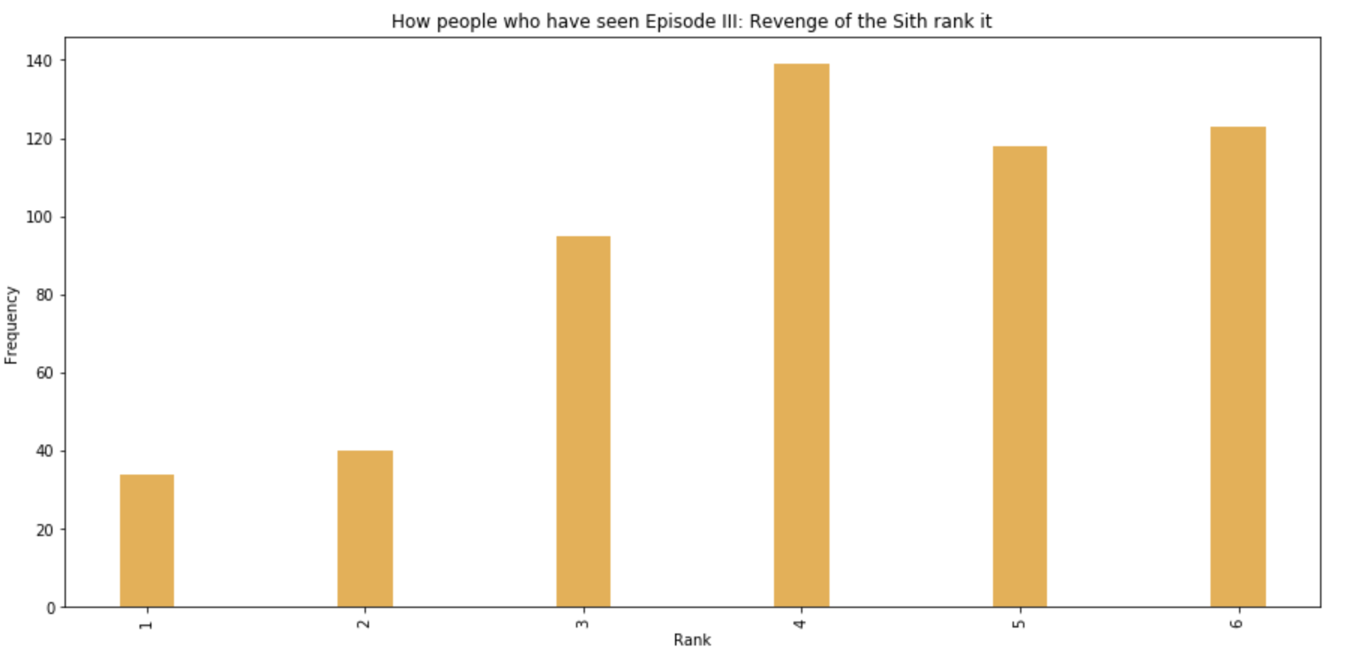
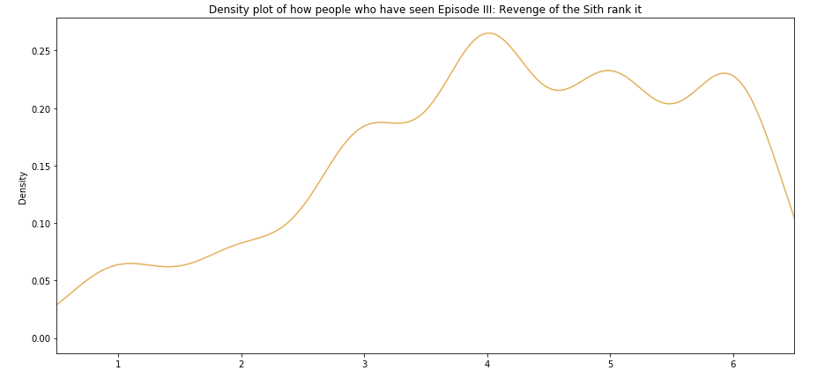
How people rank Episode iii: Revenge of the sith
Notes:
Episode 3 seems to be quite divisive, however it can be said that it is considered by the majority in the bottom 3 of all six movies
And here we have the density plot

Slide 15
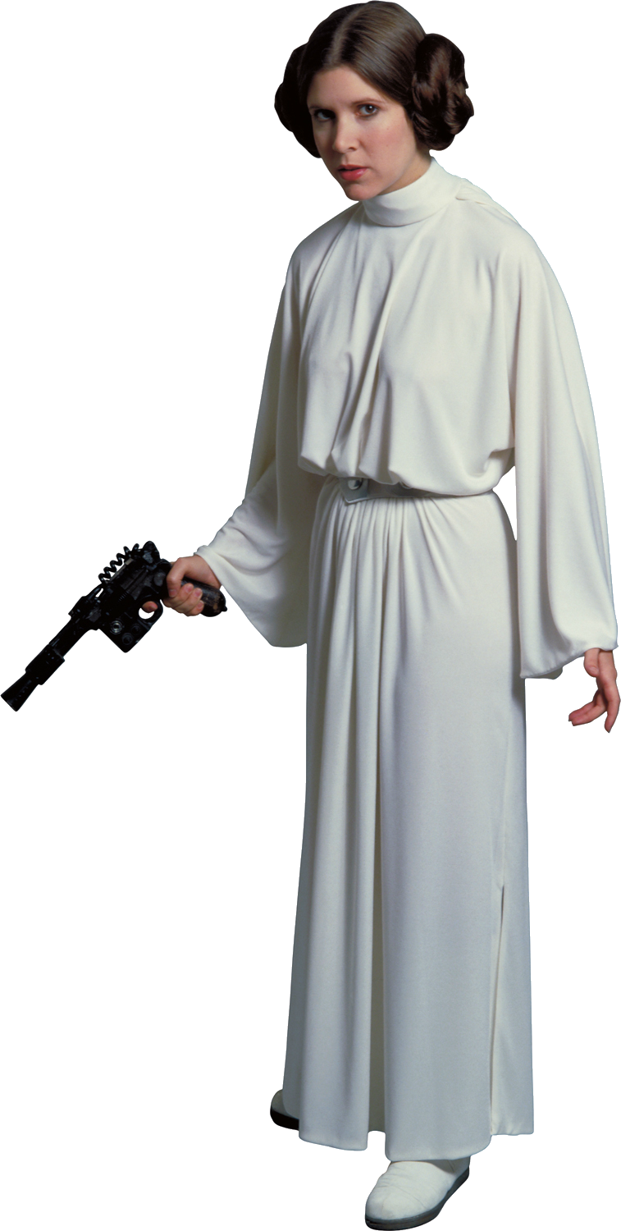
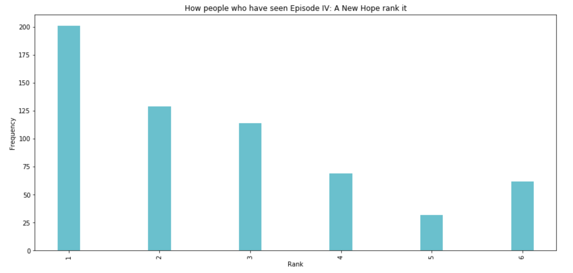
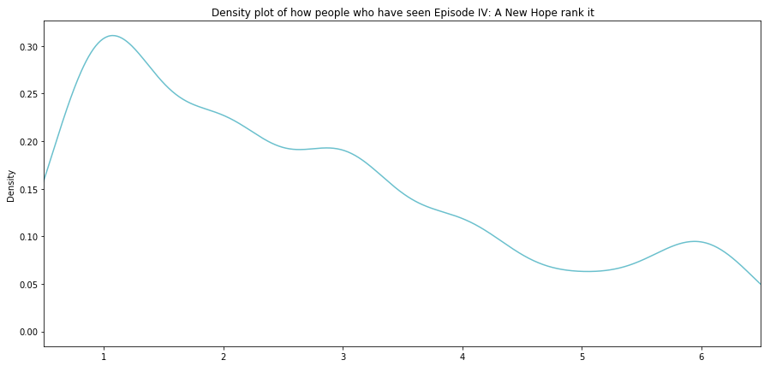
How people rank Episode iv: A new hope
Notes:
Now moving on to episode 4, we can see that a large volume of people hae ranked it as the best – nearly 200, and around 125 ranking it as the second best
The density plot reflects the same

Slide 16
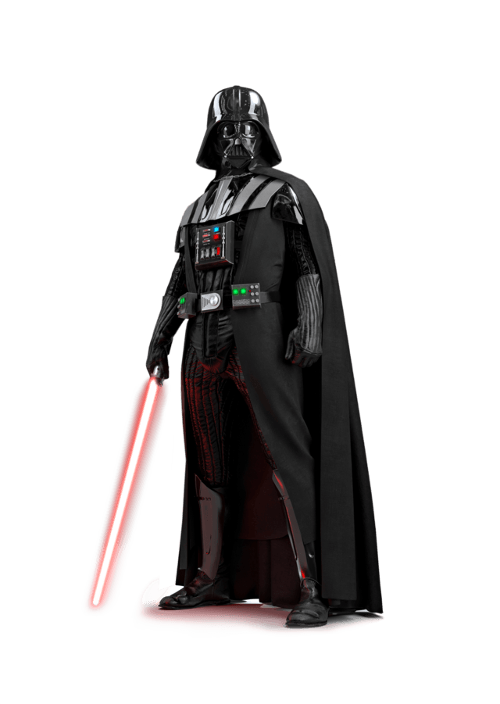
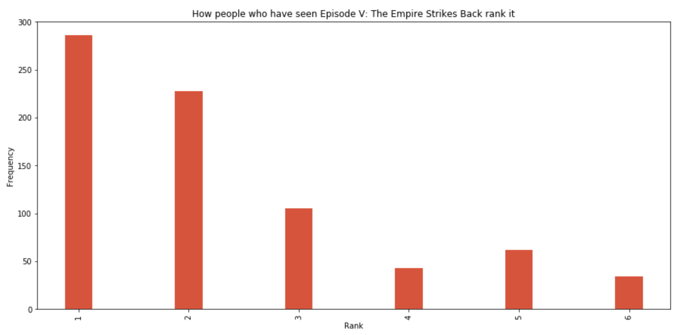
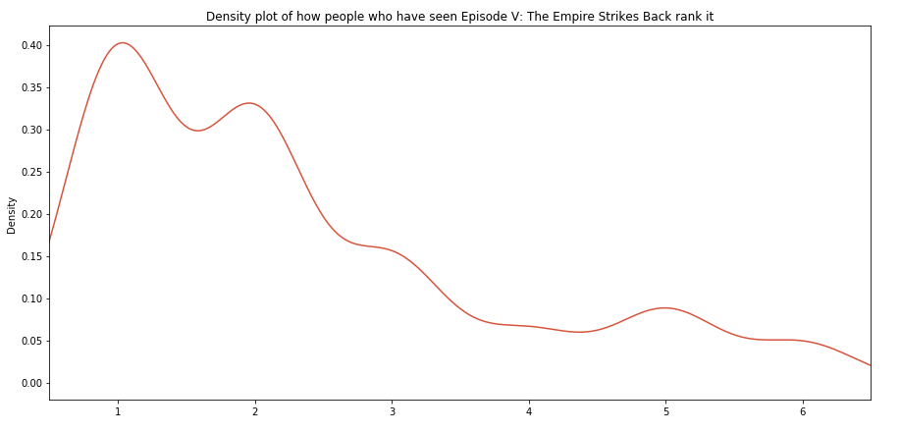
How people rank Episode v: The empire strikes back
Notes:
Episode 5 seems to be the best ranked so far, having the most number of people rank it as the best, with around 275 of them, and another 225 ranking it as the second best
And here we have the density plot that reflects the same

Slide 17

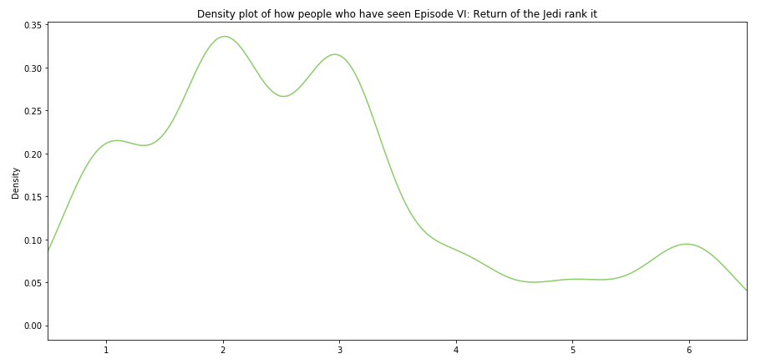
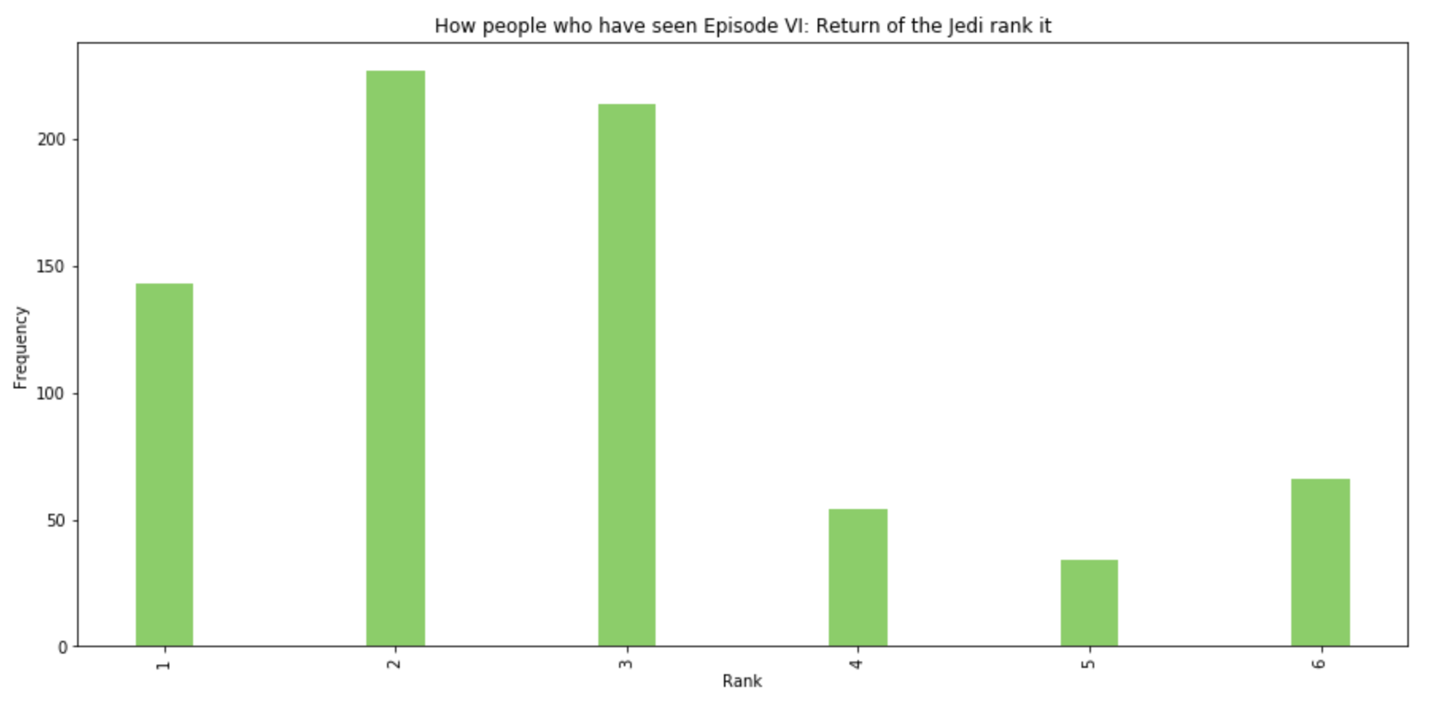
How people rank Episode vi: return of the jedi
Notes:
Episode 6 seems to be considered as either the 2nd or 3rd by most respondents
And here we have the density plot.

Slide 18
Best star wars movie?
Notes:
So this gives us an idea of how people rank the individual movies, but it still raises the question – which is the best star wars movie?

Slide 19
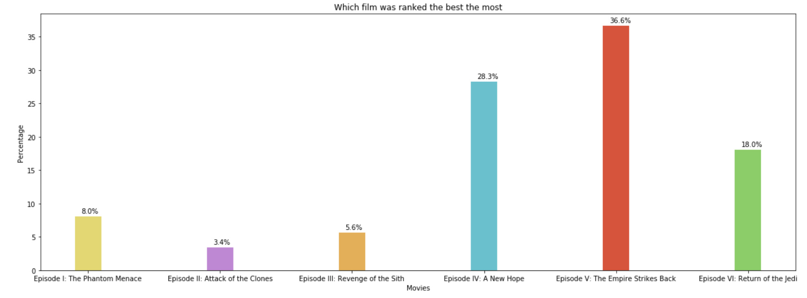
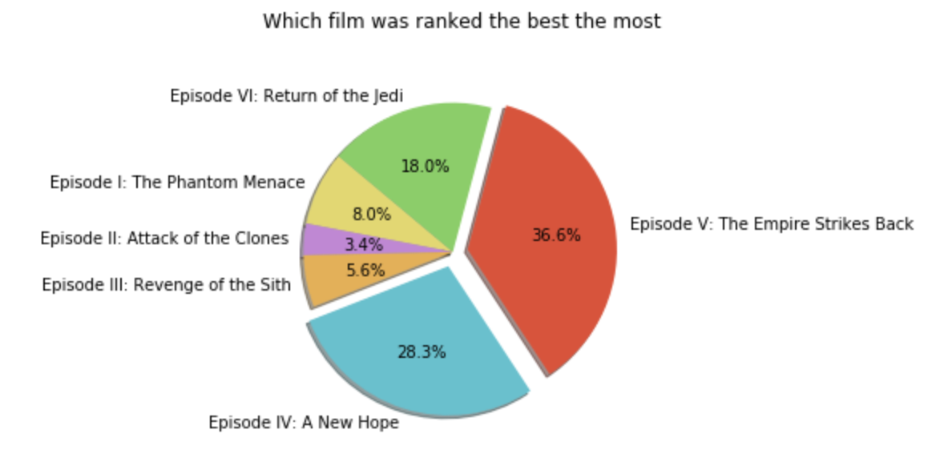
Which film was ranked the best the most
Notes:
here we have a percentage graph of which film was ranked the best the most, and we can see that episode 5 is considered the best by these respondents, being ranked as first by 36.6% of the respondents, with Episode 4 following in a close second with 28.3%
We can also see how large of a portion these movies take up in the pie chart

Slide 20
Worst star wars movie?
Notes:
What about the worst star wars movie?

Slide 21
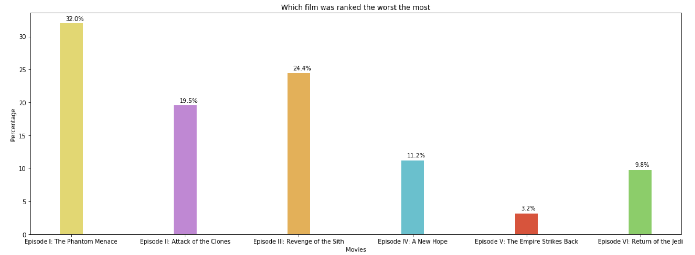
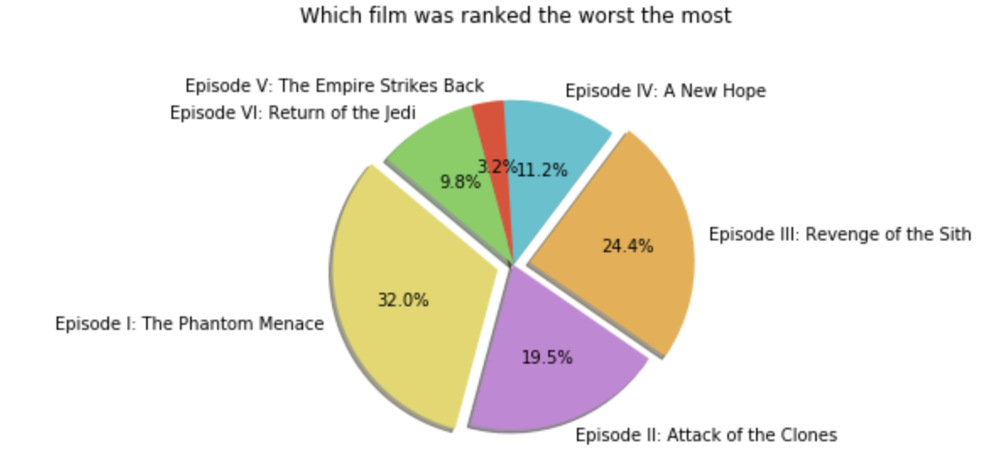
Which film was ranked the worst the most
Notes:
Phantom menace is a real menace, with 32% of respondents ranking it the worst, with revenge of the sith following with 24.4%
We can also see how large of a portion these movies take up in the pie chart

Slide 22
Relationship between columns
Notes:
Now, we move onto exploring the relationship between columns.

Slide 23
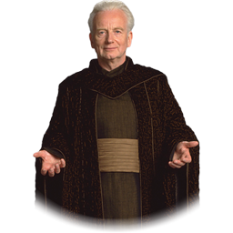
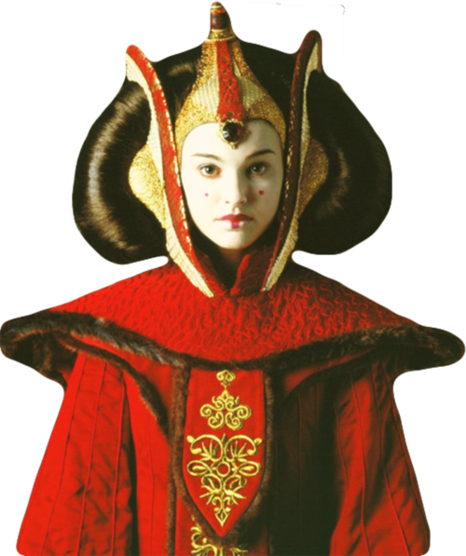
Exploration pair 1
Relationship between Respondent’s age and how they rank Episode i: The phantom MEnace
Background
Episode I was very political, with many extended sequences of the movie dedicated to diplomacy
Hypothesis
older generations would’ve understood the political aspect better and enjoyed this movie better than younger audiences, thus ranking it as the best over all others
Notes:
Boxplot gives us a good way to visualize the distribution for the different age groups and how they rank episode I – here we can see that people over the age of 60 have a tendency to rank this movie better, with people between 45-60 also ranking it favorably.

Slide 24
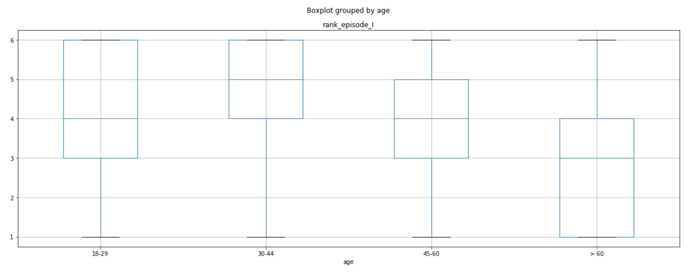
Boxplot of the relationship between respondent’s age and how they rank episode i: The Phantom Menace
Notes:
Boxplot gives us a good way to visualize the distribution for the different age groups and how they rank episode I – here we can see that people over the age of 60 have a tendency to rank this movie better, with people between 45-60 also ranking it favorably.

Slide 25
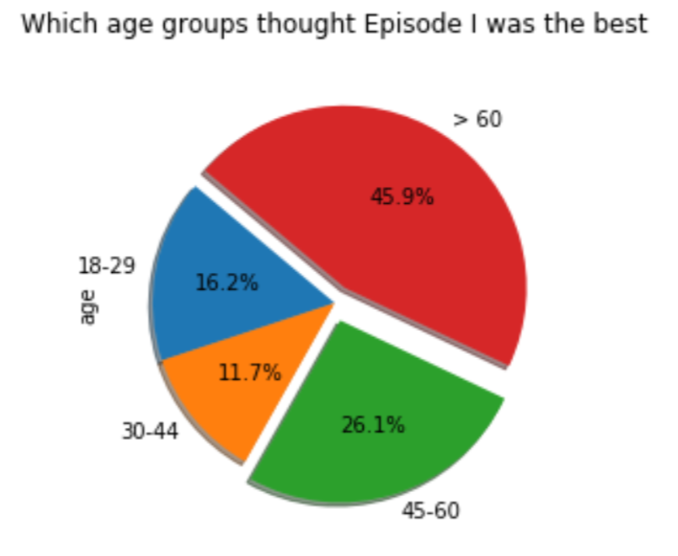
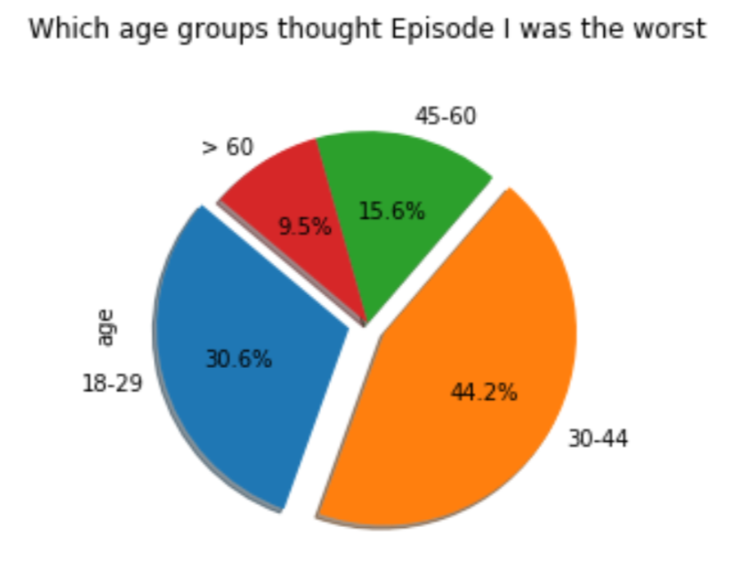
Pie charts of the relationship between respondent’s age and how they rank episode i: The Phantom Menace
72%
Of respondents who thought Episode I was the best are over the age of 45
74.8%
Of respondents who thought Episode I was the worst are aged 18-44
Notes:
We also use a pie chart to see which age groups that episode I was the best, as in ranked it no1, we can generally see that the 45-60 and 60+ categories have the largest chunks
And on the flip side, we see that the 2 younger categories in this dataset voted it the wrost.
SO from this we can see results, thus supporting the hypothesis.

Slide 26


Exploration pair 2
Relationship between respondents who consider themselves fans, and their subsequent answer to the notoriously debated question ‘Who Shot First?’
Background
The original scene in Episode IV had Han Solo shoot Greedo first, but this was later changed in subsequent versions of the movie
Hypothesis
Real fans should know that Han shot first, or at the very least, understand the question.

Slide 27
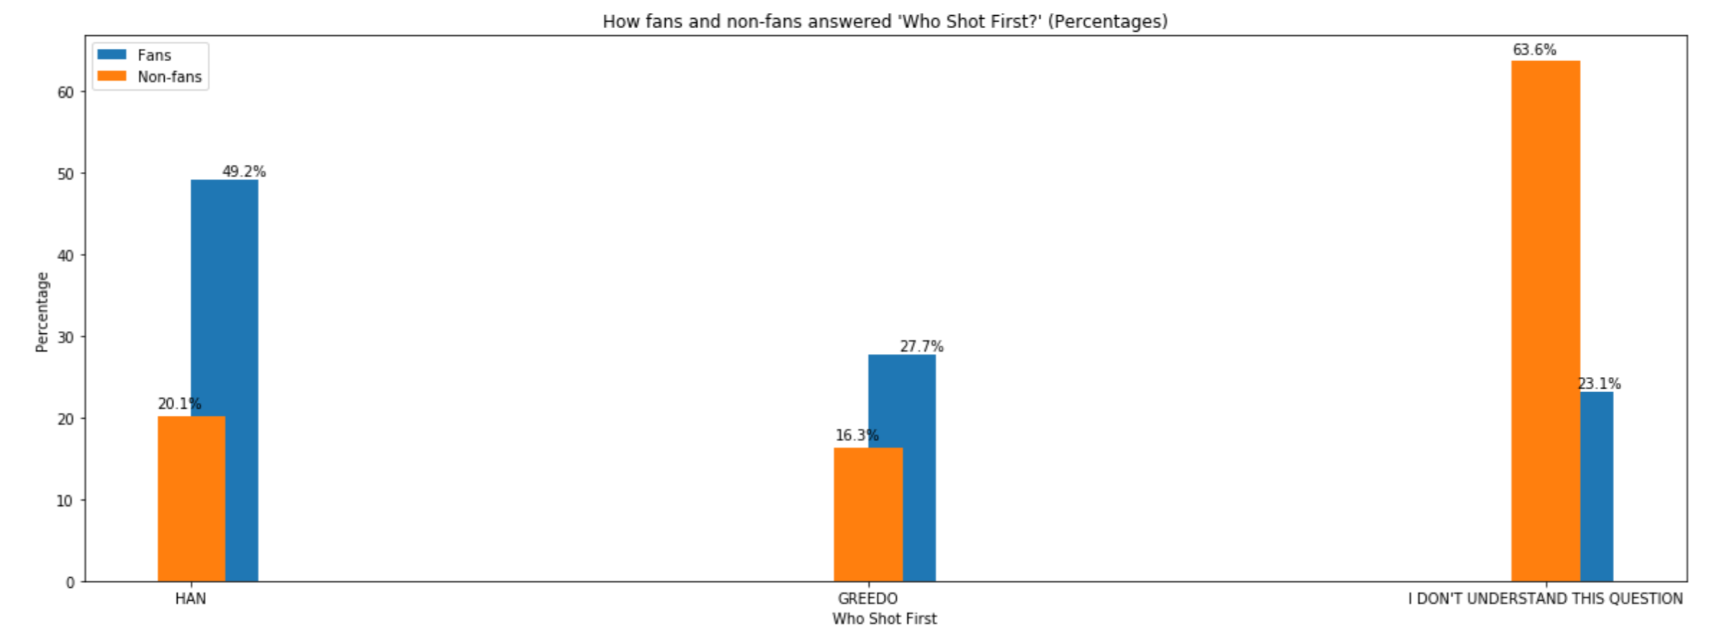
Bar graph of how respondents answered the question ‘who Shot first?’
Notes:
Here we can see that Fans answered Hand 49.2% of the time, and 27.7% fans got it wrong by saying it was greedo. Only 23.1% of fans didn’t understand the question,
For the non fans we can see the majority of them didn’t understand the question

Slide 28
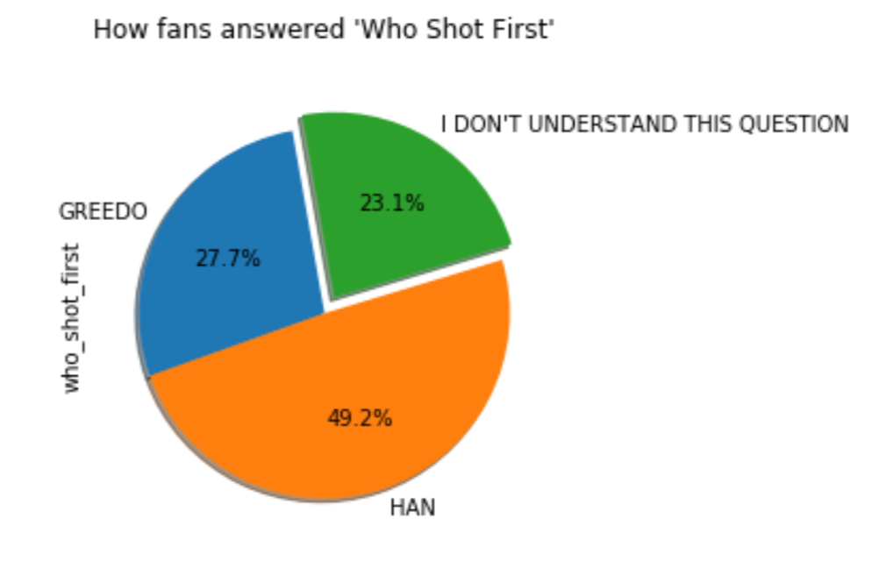
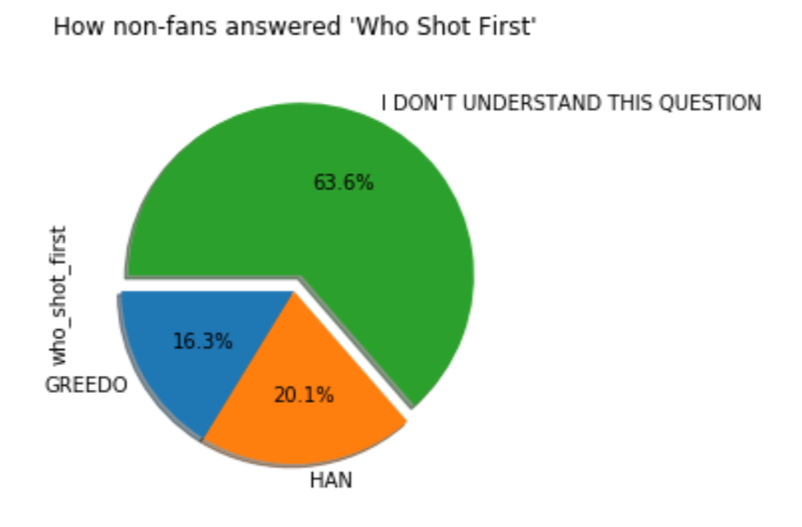
Pie charts of how fans and non-fans answered the question ‘who Shot first?’
49.2%
Of respondents who are fans answered ‘HAN’
76.9%
Of respondents who are fans understood the question
63.6%
Of respondents who are not fans did not understand the question
Notes:
We can visualize these as individual pe charts, and we can see that a majority of fans who understood this question, slightly nearing double, said Han shot first
Thus supporting the hypothesis

Slide 29
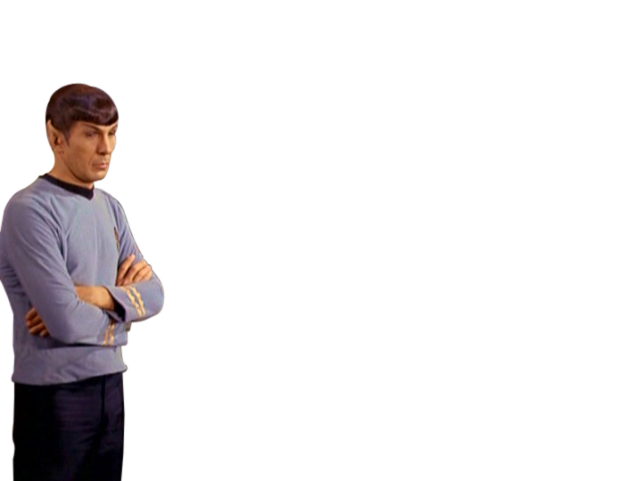
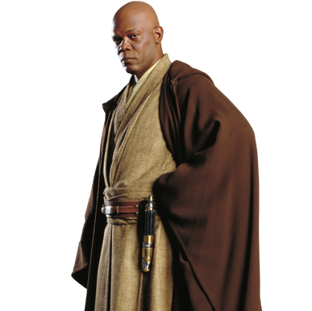
Exploration pair 3
Relationship between respondents who are Star Wars fans and Star Trek fans
Background
People’s love for both these properties is so much, that there is a bit of a rivalry between the two fandoms.
Hypothesis
due to this intense rivalry, it is likely that we may find in The data that people only consider themselves fans of one of the franchises, but not both
Notes:
Explore the animosity between people who are fans of either franchise

Slide 30
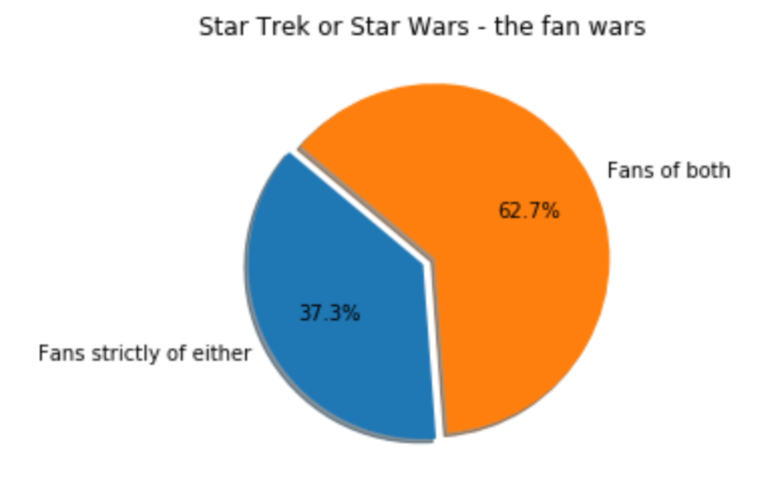
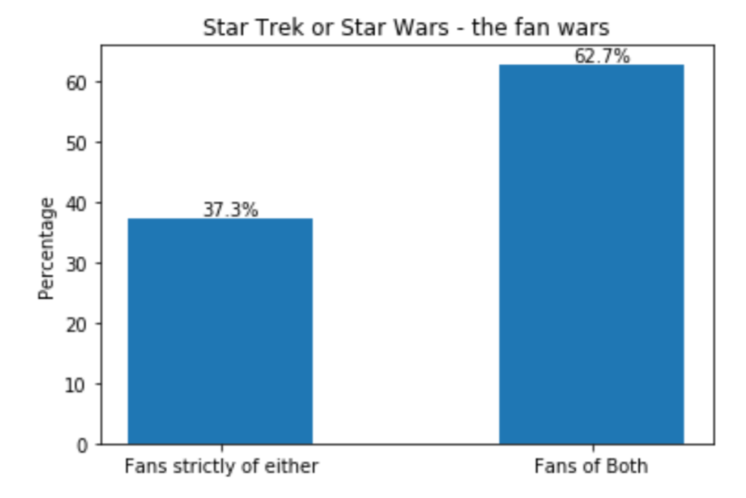
Bar graph of how respondents answered the question ‘who Shot first?’
62.7%
Of respondents are fans of both franchises
37.3%
Of respondents are fans strictly of either one
Notes:
In order to explore, and get ‘fans strictly of either’, we took the number of respondents who are fans of star wars and not star trek, and the number of fans who are fans of star trek but not star wars, and added them both.
We then took the number of respondents who had marked themselves fans of both, and took the percentage of each of these two values from their total.

Slide 31
Character affinities by Demographics
Notes:
Now we look at the character affinities, or people’s attitude towards star wars characters by their demographics.
For this task, we looped through every character and every demographic and generate stacked percentage bars showing likeliness towards characters for each unique segment. This gives us some interesting insights

Slide 32
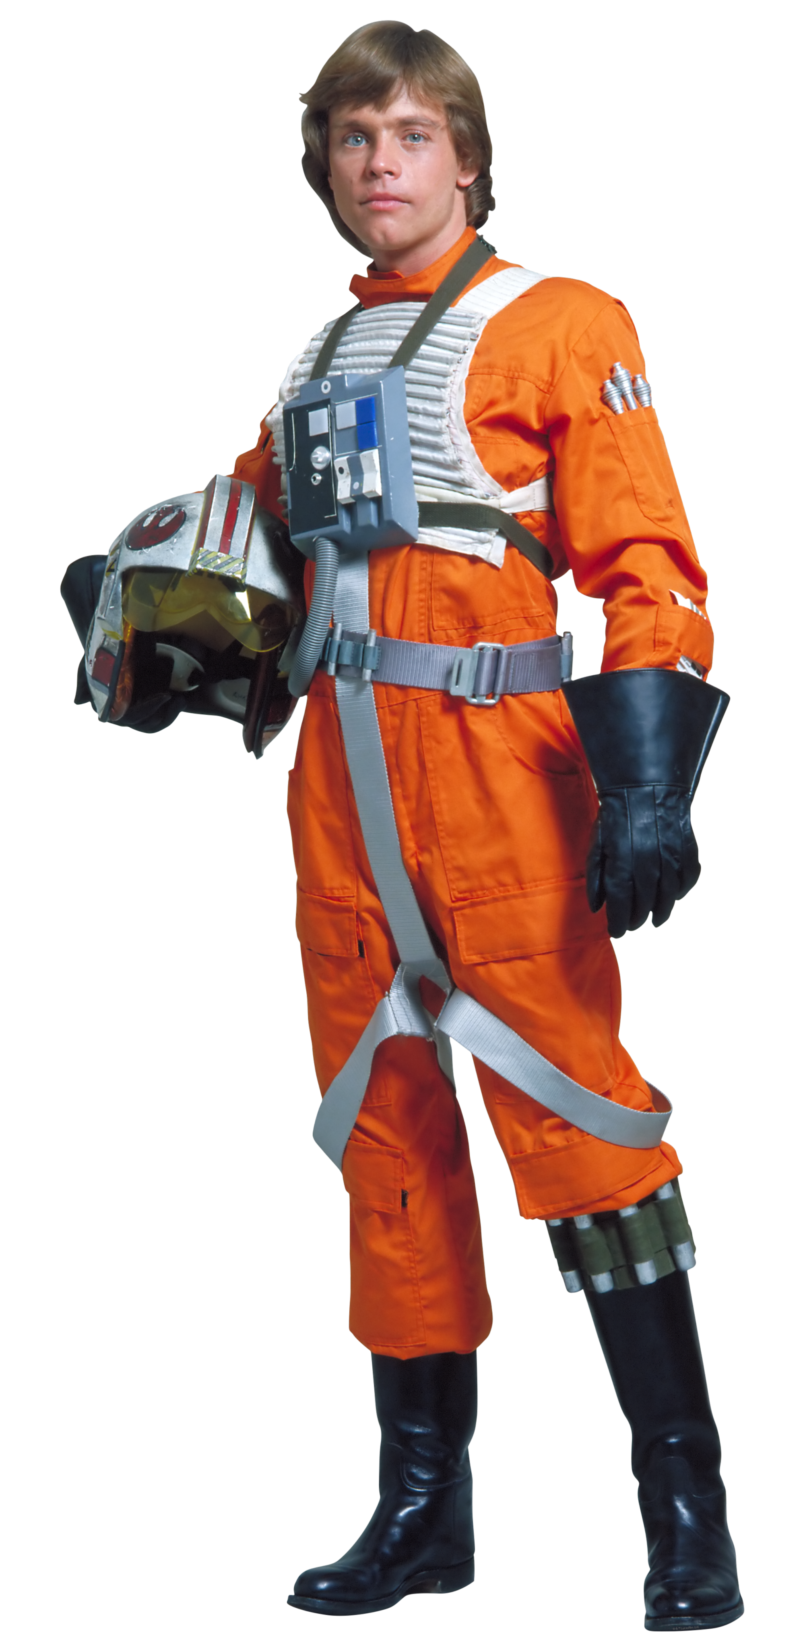
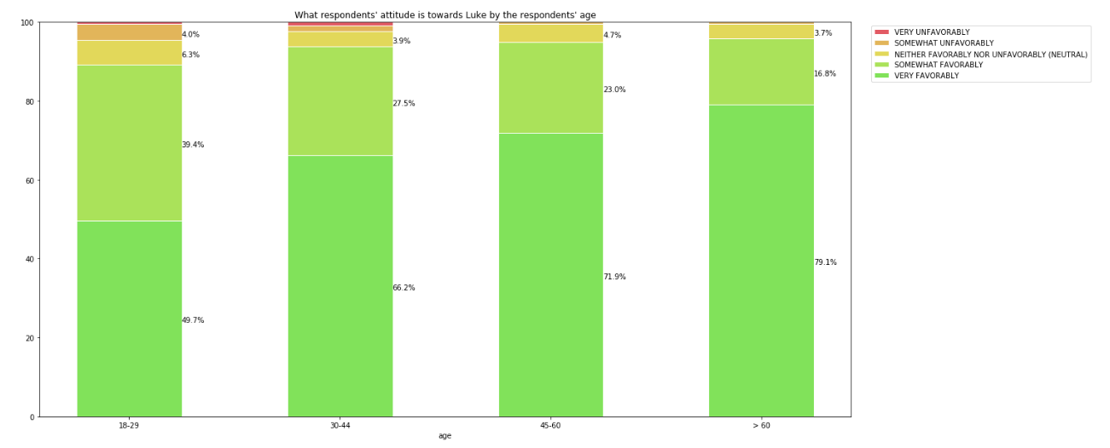
Respondents’ attitude towards luke skywalker by age
Notes:
The favourability towards Luke Skywalker increases as respondents get older.

Slide 33
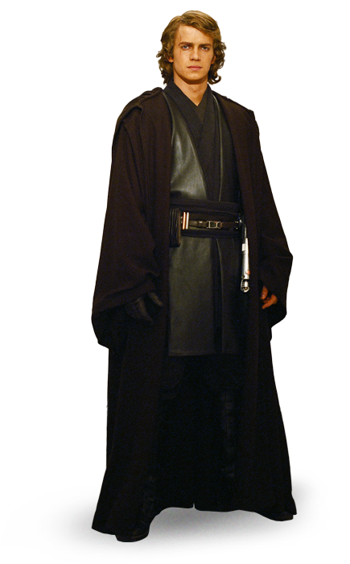
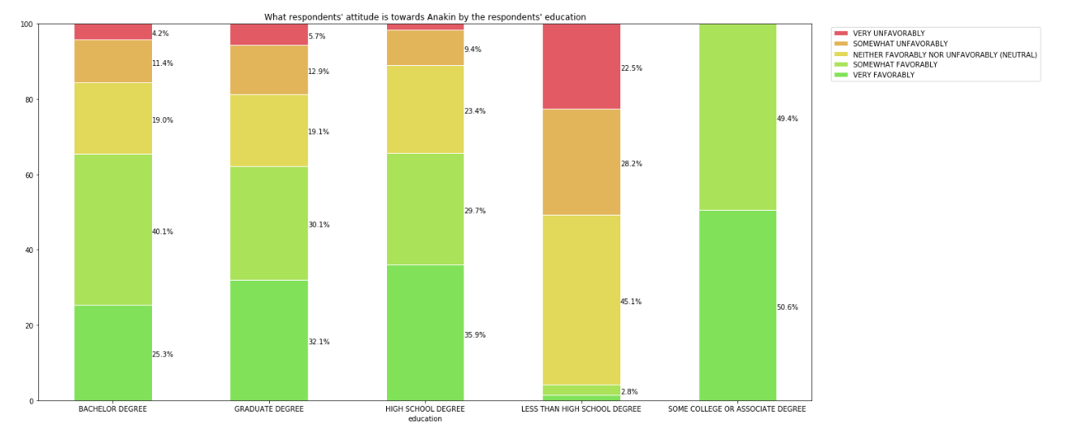
Respondents’ attitude towards Anakin by age
Notes:
There is a somewhat even divide in the favourability of Anakin, however interestingly, respondents with less than a high school degree only found the character some kind of favourable only a small 4.2% of the time.

Slide 34
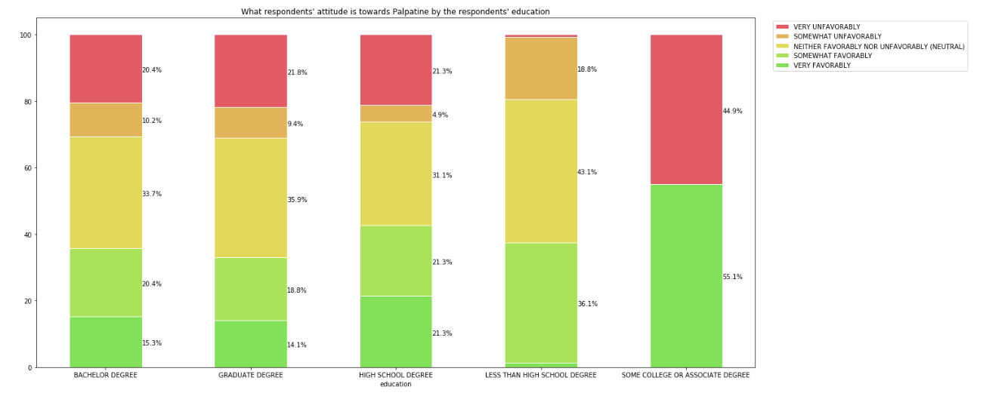
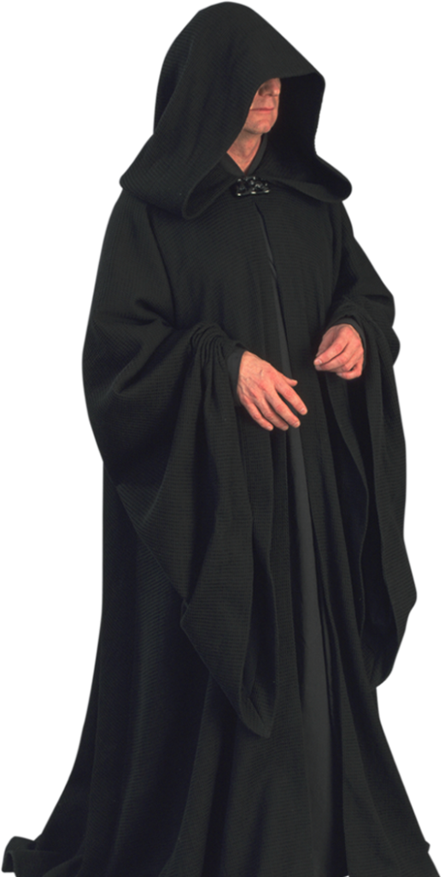
Respondents’ attitude towards palpatine by education
Notes:
people with some college or associate degree either love or hate Emperor Palpatine.

Slide 35
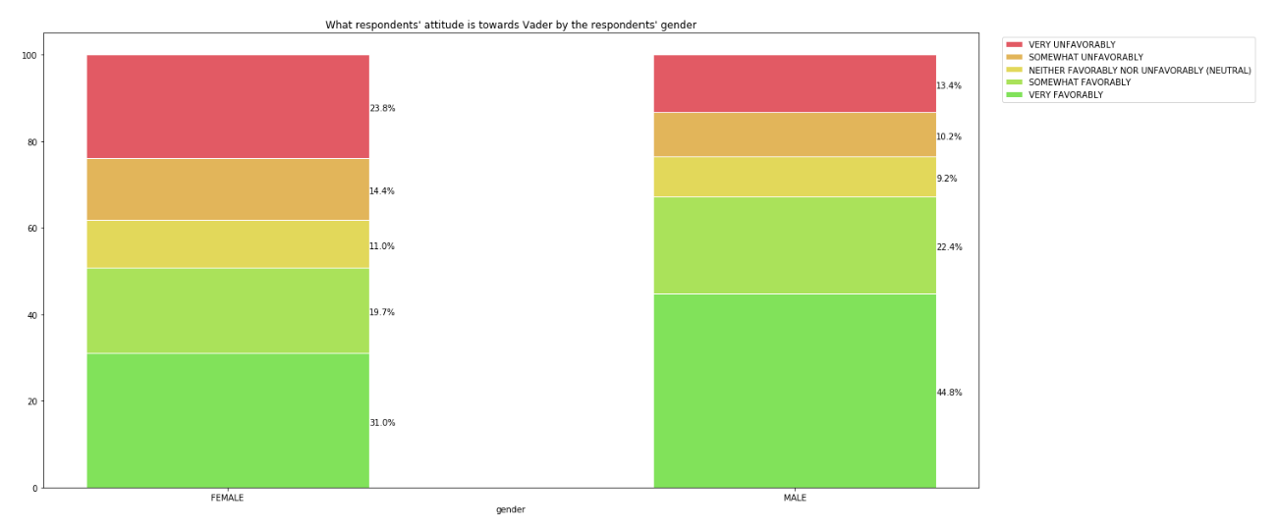
Respondents’ attitude towards Darth vader by gender
Notes:
Women find Darth Vader ‘Very Unfavorable’ by 10.4% more than men. Consequently, men find Darth Vader ‘Very Favorable’ by 13.8% more than women

Slide 36
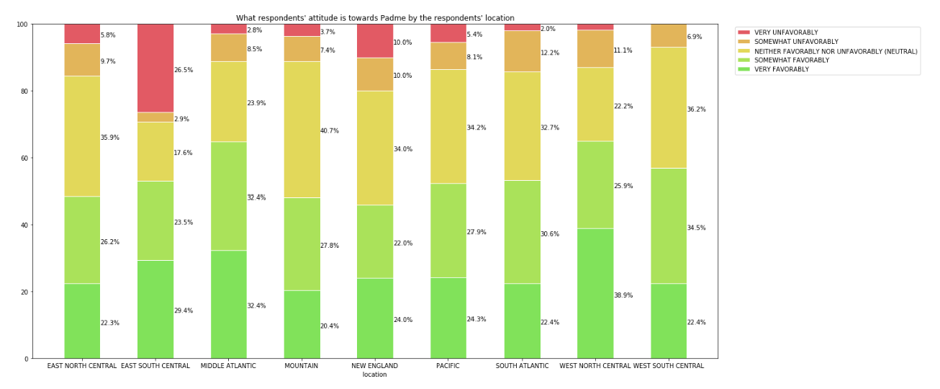
Respondents’ attitude towards Padme by Location
Notes:
Respondents living in the East South Central have the highest unfavorability towards Padme, with 26.5% finding her character ‘Very Unfavorable’.

Slide 37

Thanks!
Notes:
That’s the end of the presentation, thanks for tuning in!

